Slide 1
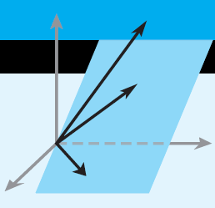
Elementary Linear Algebra
Howard Anton
Copyright © 2010 by John Wiley & Sons, Inc.
All rights reserved.
Chapter 8

Slide 2
Chapter 8
Linear Transformations
8.1 General Linear Transformations
8.2 Isomorphisms
8.3 Compositions and Inverse
Transformations
8.4 Matrices for General Linear
Transformations
8.5 Similarity

Slide 3
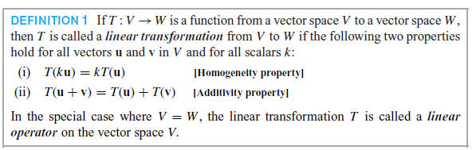
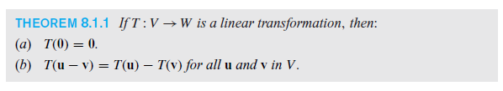
Section 8.1 General Linear Transformations

Slide 4
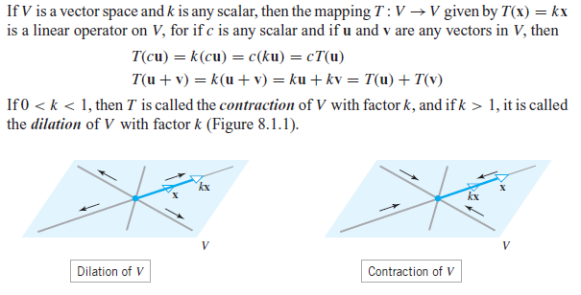
Dilation and Contraction Operators

Slide 5
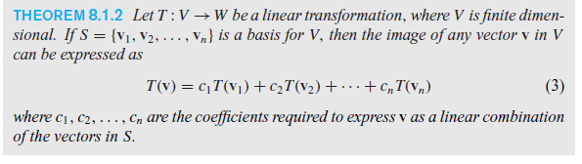

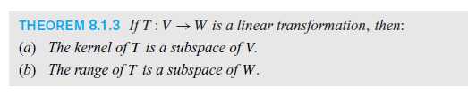
Image, Kernel and Range

Slide 6
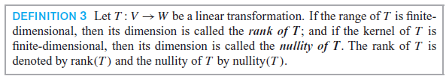
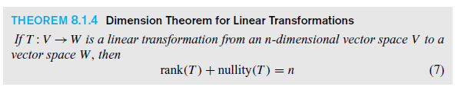
Rank, Nullity and Dimension

Slide 7
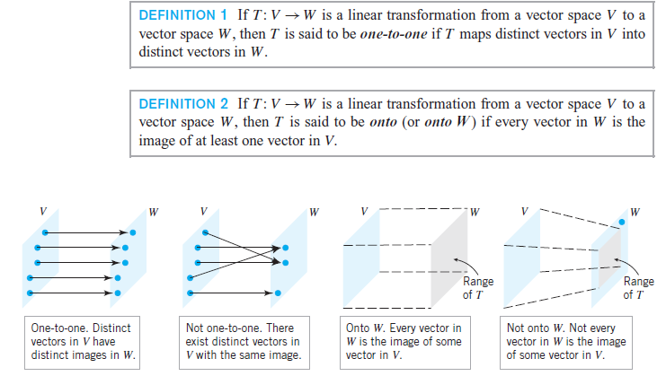
Section 8.2 Isomorphism

Slide 8
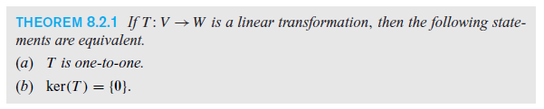
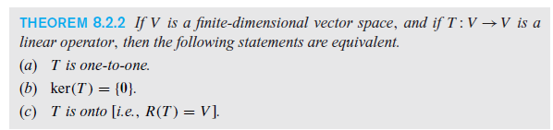

Isomorphism

Slide 9
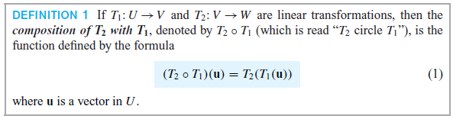
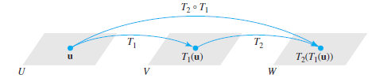
Section 8.3 Compositions and Inverse Transformations

Slide 10
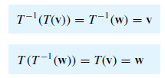

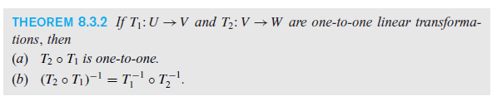
Inverses

Slide 11
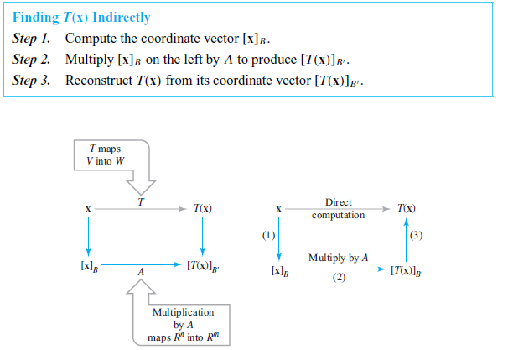
Section 8.4 Matrices for General
Linear Transformations

Slide 12
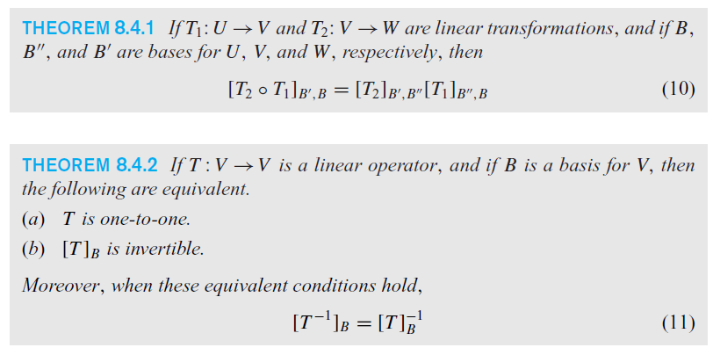
Matrix of Compositions and Inverse Transformations

Slide 13
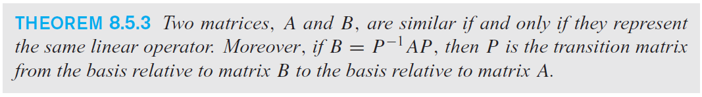
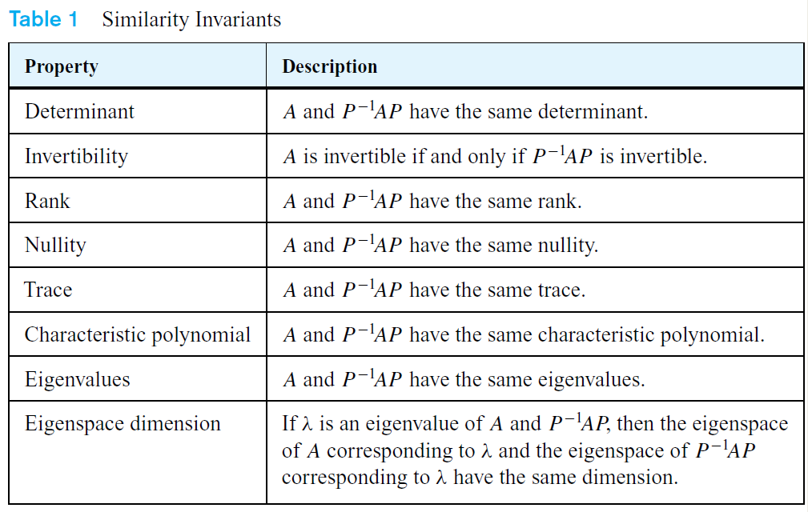
Section 8.5 Similarity

